Slide 1

Relocation Project:
New EU Location: Amsterdam
Project Manager: Nolene Dube
Budget: £500,000,00
End Date: 1st July 2024

Slide 2
Requirements:
Hatched Consultants have an ongoing international expansion plan to be executed beginning of 2025. The EU segment of the project has been fast forwarded to mitigate against potential delays caused by Covid 24 Lockdowns.
Requirements:
Opening of EU office in Amsterdam or London (Bigger location)
Relocation of 6 experienced staff
Onboarding for 6 new recruits
Location should have potential for future employees
Project Objectives: What do I need from you?
Project Charter
WBS - with priority, estimates and work packages percentages
Stakeholder Grid (Influence / Interest)
High Level Timeline *Bonus*
Traffic Light Risk Assessment (Risk & Issues) & how would you mitigate?
Confirmation on what activities have Dependencies?
How would you ensure necessary decision makers are engaged?

Slide 3
Stakeholder Grid
Name | Title | Influence/Priority | Decision Maker | Communication
Slie | Sponsor | High | Yes | Project Management Plan Weekly Meetings Daily Reports &Emails
Mimi | MD | High | Yes | Project Management Plan Weekly Meetings Daily Reports &Emails
Norma | Finance & Procurement | High | Yes | Project Management Plan Weekly Meetings Daily Reports & Emails
Nqobani | Recruitment | Medium | Yes | Project Management Plan Emails
Angie | Human Resources | High | Yes | Project Management Plan Weekly Meetings Daily Reports & Emails
Dom | Local Experts | Medium | No | Emails &Meetings
Unknown Yet | New Recruits | High | No | Emails & Zoom Video Meetings
Gil, Siya, Mbali, Vin, Sue, Terry | Experienced Relocation Staff | Medium | No | Emails & Meetings
Amy, Adele, Tim | Dutch Office Design Consultants | Low | No | Adhoc Video Calls

Slide 4
Project Charter
Reasons:
Mitigating Risk of Expansion Plans By Potential Covid 24 Lockdowns
Company Objectives to expand the business Internationally by End of 2025
Constraints: Under pressure from new Covid Regulations and Potential Lockdowns.
Risk Identified:
Legal Process Delays
Lack of qualified application
Lockdowns
Overview of the budget: Total Spending £290,000 Est
Human Resources: £200,000 40% Legals: £50,000 10% Recruitment: £10,000 2% Others: £30,000 6%
Main Stakeholders:
Sponsor
Managing Director
Finance & Procurement
Recruitment
Human Resources
Local Experts
Experienced Relocation Staff
Benefits of the Project:
Have a registered branch and office in Amsterdam before Covid 24 Lockdowns
Achieve EU Expansion Segment of Entire International Expansion Plan 1Year Early

Slide 5
Project Scope
Approved Project Scope:
Phase 1:
Registering a new company
Work visas
Central Amsterdam office location
Relocation Packages and Care Packages to Staff – £10k Relocation Bonus and £10k Salary Increase, Car Allowance (£250 P/M) and 1 Years Rent Paid {700 P/m}
Phase 2 :
Hiring New 6 Recruits staff
Accommodation for staff
Travel Arrangements
Phase 3:
New Staff Online Training
Staff Relocation
Office Supplies and Machine shipping and organising
Phase 4:
Amsterdam office opening
In-person Staff Training
Staff Relocation offer packages

Slide 6
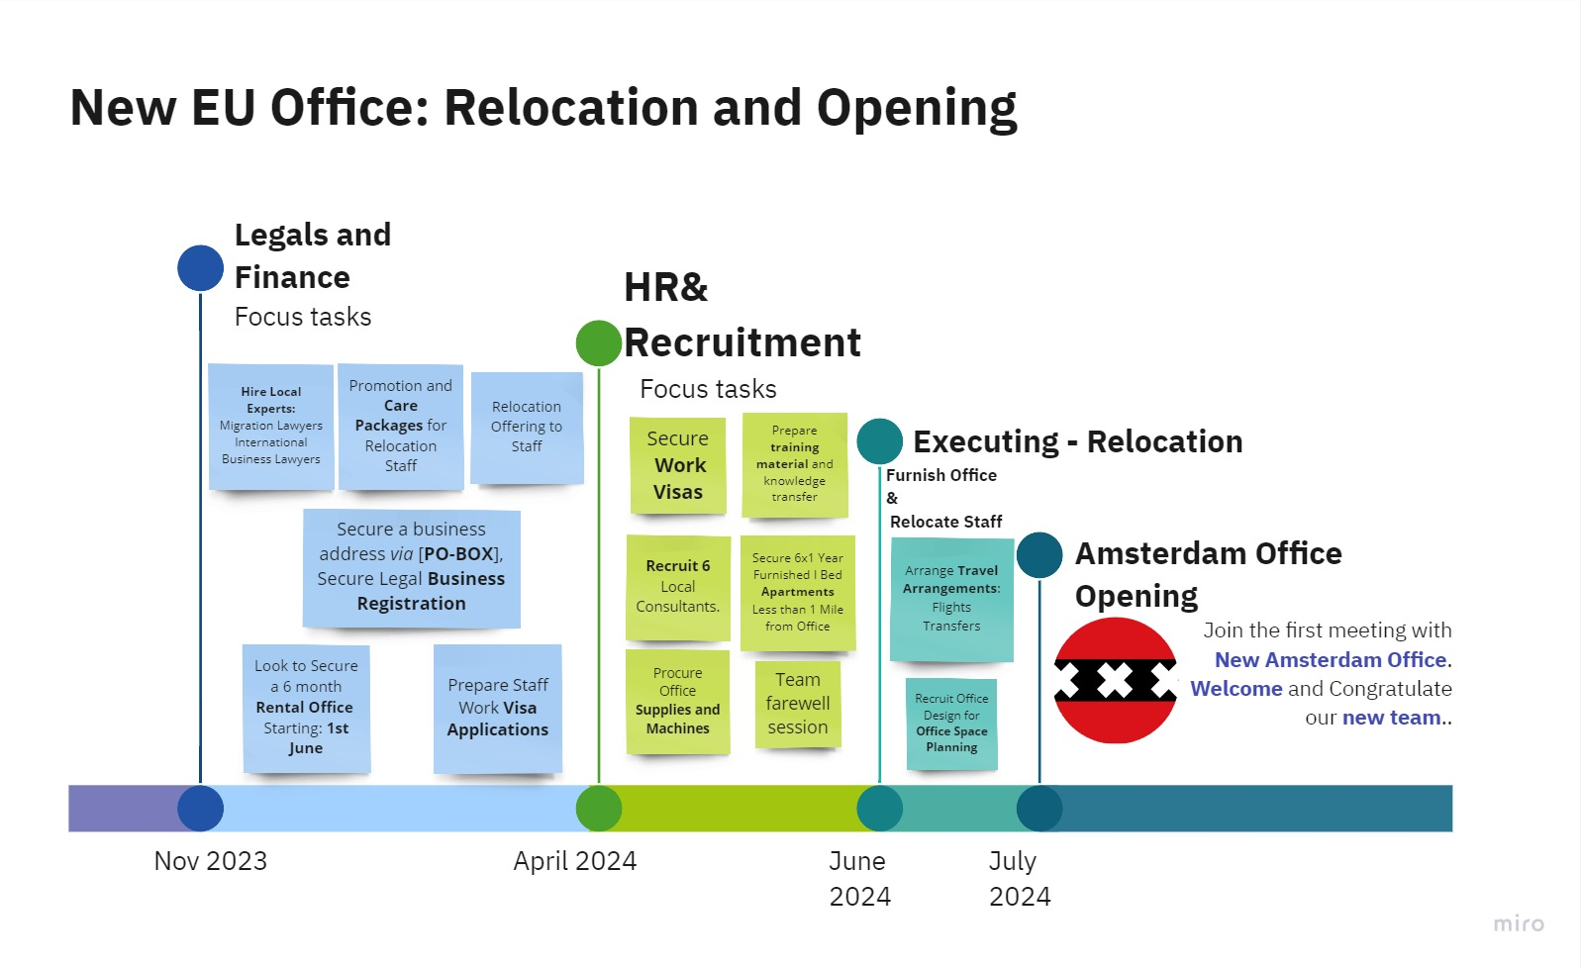
TimeLine

Slide 7
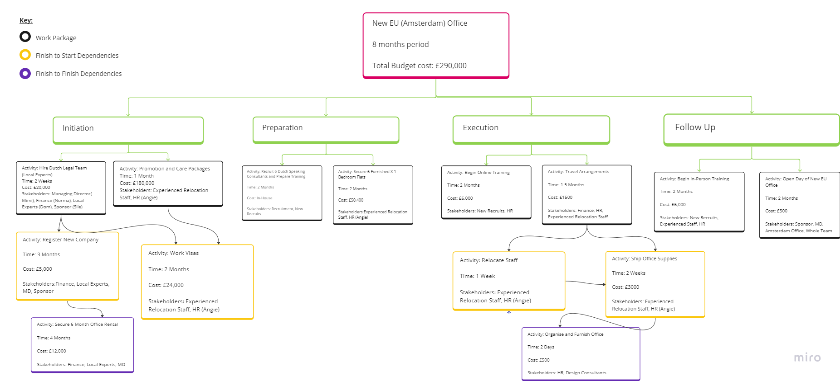
WBS & WBS Key & Dependencies

Slide 8
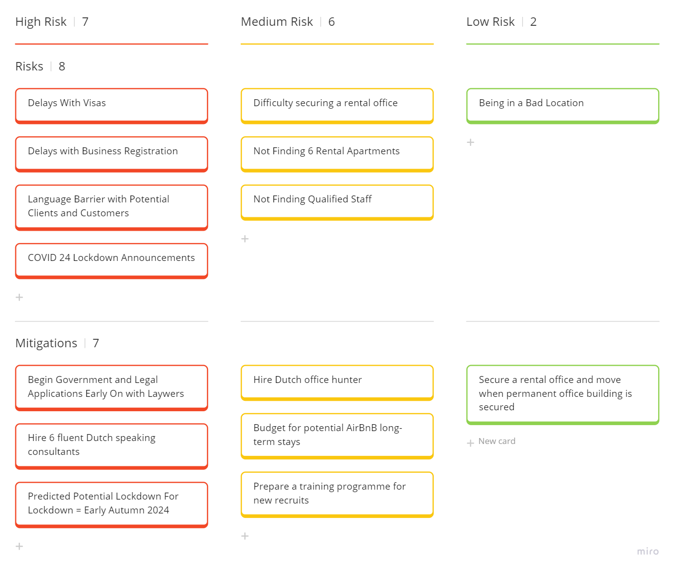
Risk Assessment: Adapting Kanban to Traffic Light System

Slide 9
Scope Control Statement
All relocation project approved deliverables have been satified apart
Sourcing a Location that should have potential for future employees
After intensive research and discussions. Hatched Consultants Decision Maker and Stakeholders concluded that the need to find the perfect office was not as important as the need to have an established branch in Amsterdam with a strong initial team, before new legislation or regulations regarding Covid 24 had taken effect potentially delaying our entire expansion plan.

Slide 10
What Went Well?
This is about executing the actual Project for The Project Management Module:
What went well:
Adapting Different Frameworks for alternative purposes e.g Kanban for Risk Assessment
Using visual tools as part of the projects
I enjoyed the process of brainstorming all the components/ mini projects required to achieve the overall deliverables.
What we could do better:
I could have started the project sooner so I could have filled it with as much information as I was inspired to dive deeper and more creative with.
I will build a more in-depth project management plan to upload onto GitHub

